Slide 1
Code Slayer
Tic Tac Toe Game
By Elvis, Akshay, Luis, Stephanie, Nick
Notes:
1
1

Slide 2
Role of each member
Elvis Jimenez | Team lead, developer and architect of the GUI interface.
Akshay Patel | Sub team lead and architect of the single player mode (PvP).
Luis Oropeza | Tester and secretary
Stephanie Reyes | Secretary and Tester.
Nick | Architect of the AI.
Notes:
2
2

Slide 3
Preliminary Requirements

Slide 4
Modification History
9/9/16 The product design layout has been developed.
9/16/16 The product design layout has been improved with features.
9/23/16 The coding has begun and a 5X5 board has been created
9/30/16 The product has the single or multiplayer feature

Slide 5
Domain Knowledge
Glossary
Term | Definition
5x5 Tic Tac Toe | A game can be played with two players using X and O signs. The player who succeeds in placing four of their marks in a horizontal, vertical, or diagonal row wins the game.
GUI(Graphical User Interface) | Two people can operate it using keyboard and mouse
Platform | OS based on the which software the game is running
SDL | Extensive library for C++
Visual Studio | Integrated development environment for implementing the code
One Player | A player play against the computer
Multi Player | More than one player can play with each other.
Difficulty Level | In one player, player can play it in easy, medium and hard levels.

Slide 6
Acronym | Meaning
GUI | Graphical User Interface
SQA | Software Quality Assurance
AI | Artificial Intelligence

Slide 7
USE CASES
Goals of actor | To play Tic Tac Toe casually during one’s free time.
Tasks | Player 1 starts the game initially. At this point the software should create the grid so the player can choose whether to play against the AI or against another human player. Next, the player chooses the difficulty or skill level to start the actual game.
Preconditions | Empty grid, in other words a “New” game.
Exceptions | If a previously played game is in progress, an error message is shown
Variation of action interactions
System change/production

Slide 8
Use Case 2
Goals of actor | User name to be registered
Task | Initially register a user name to start playing the game
Preconditions | No user name is registered
Exceptions | Error message is shown if name is already registered or duplicated
Variation of action interactions
System change/production

Slide 9
Use Case 3
Goals of actor | Logging in to the game
Task | Choose previously registered username to log in to the game.
Preconditions | Player has to be registered in order to log in to the game
Exceptions | If user name is invalid, an error message is shown.
Variation of action interactions
System change/production

Slide 10
Use Case 4
Goals of actor | Create New Game
Task | A new clean game is started after the previous game has ended.
Preconditions | An “existing” game has to ended or canceled in order to create a new game.
Exceptions | A New game is loaded only after the software is opened or when the current game has ended.
Variation of action interactions
System change/production

Slide 11
Use Case 5
Goals of actor | Single Player mode
Task | One single player against one AI when playing the game.
Preconditions | Only to be used in the software while playing against the AI.
Exceptions | Single player is only applicable against AI
Variation of action interactions
System change/production

Slide 12
USE CASE 6
Goals of actor | Skill level difficulty
Task | To assign a certain level of difficulty before a new game starts.
Preconditions | Player has to choose a skill level of either easy, medium or hard in order to start playing the game.
Exceptions | Can only be used against another player or the AI
Variation of action interactions
System change/production

Slide 13
Use Case 7
Goals of actor | Score Display
Task | Display the number of winnings and loses of the players.
Preconditions | Game has to have ended in order for the screen to display scores
Exceptions | No score will be available unless a game has been played and a game has been decided.
Variation of action interactions
System change/production

Slide 14
Use Case 8
Goals of actor | Exit game
Task | Exits the game being played
Preconditions | The game has to be currently running, or simply “open” or must be finished in order to quit the game.
Exceptions | Can’t quit the application if there is no game in process
Variation of action interactions
System change/production

Slide 15
Non-Functional Requirements
Cost Constraints: The project has a budget of $0.00. No further maintenance costs will be required in the future.
Reliability: The software has a shelf life of 2 years after its final release. Updates will provided until its requirement
Time Constraints:
The time constraints are finding time to accommodate everyone’s availability to meet. Also, we need to organize adequate allotted time to completing the project. The software will be available by December 2016.

Slide 16
Current Developments
Implementation of game hard level
Implementation of user registration
Implementation of database for game history
Notes:
16
16

Slide 17
Pending Developments
Implementing all functionalities of game usage in the classes.
Code completion for easy and medium level
Implementing all use cases in testing iterations
Notes:
17
17

Slide 18
Types of Testing
Glass-box testing: Branch Testing
Execution based testing
User Interaction testing
Notes:
18
18

Slide 19
Glass-box Unit Testing
Branch Testing
Begin as an existing player or guest.
Game playing mode: Player vs AI.
Level of difficulty selection
Selection of user that begins to play
Notes:
19
19

Slide 20
Execution Based Testing
Testing for the following components in our program:
Reliability
Robustness
Performance
Utility
Correctness

Slide 21
User Interaction Testing
Start game
Display score
Select difficulty level
Check if board is full
User adaptability to GUI
Notes:
21

Slide 22
Use Cases
Case 1: Register new account or guest | Set up username and password for new user to log into the game.
Case 2: Login as existing user | Enter the username and password to log into the game.
Case 3: Display player scores for registered users | Displays the user’s Win/Loss record.
Notes:
22
22

Slide 23
Use Cases
Case 4: Player vs. Player | User selects game mode to play against another player.
Case 5: Player vs. AI | Choose to play the game against against the AI.
Case 6: Difficulty level | Adjust the AI difficulty level to Easy, Medium or Hard.
Notes:
23
23

Slide 24
Use Cases
Case 7: New Game, Exit | User gets asked if they wish to start a new game, then is taken to game mode selection. Exits the current window and goes to the previous one.
Notes:
24
24

Slide 25
Detailed Use Case Examples
Use Case: 1
Goals of actor | Create player or guest for Tic Tac Toe game.
Tasks | Player needs to open the program and needs to create a player or play as a guest
Preconditions | Needs to start a new game.
Exceptions | Player already exist.
Variation of action interactions | N/A
System change/production | N/A

Slide 26
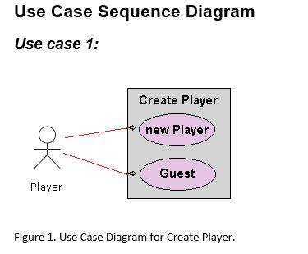
Use Case: 1 Create player or guest for Tic Tac Toe game

Slide 27
Continue…
General Description
This enables for user to create a new player or sign in as a guest.
Use Case 1: Creating a player
Brief Description Allows a new player to sign in with player name.
Step-by-Step Description Player inputs name and signs in. Player will be allow to see the record of wins and losses.

Slide 28
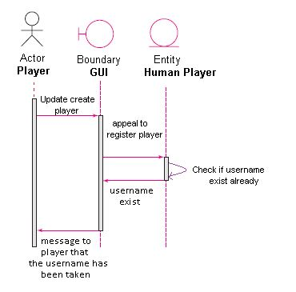
Continue…
Sequence Diagram

Slide 29
Continue…
Use case 1: Player name already exist (anomaly 1)
Brief Description Player username already exist.
Step-by-Step Description Player uses name that already exist Player will get a message that informs player that the username is already taken.

Slide 30
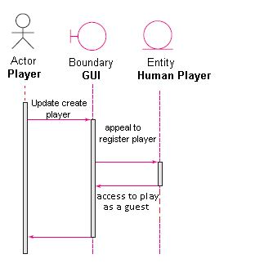
Continue…
Sequence Diagram

Slide 31
Continue…
Use case1: Player plays as a guest. (Anomaly 2)
Brief Description Player plays as a guest.
Step-by-Step Description Player does not need a username and plays as a guest. Guest player will not create a report of wins and losses.

Slide 32
Use Case: 7 (Example for Exit game or New game)
Use Case: 2
Goals of actor | Player chooses to exit game or new game
Tasks | Exits the game being played or starts a new game
Preconditions | The current game must be finished in order to quit the game or start a new game.
Exceptions | If there is no game, can't exit the game of start a new game.
Variation of action interactions | N/A
System change/production | N/A

Slide 33
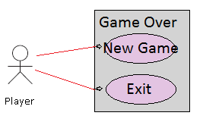
Continue…
Use Case Diagram for Game Over

Slide 34
Continue…
General Description
This enables for user to start a new game or exit the game.
Use Case: Starting new game
Brief Description Allows a player to start a new game.
Step-by-Step Description Player clicks new game. Player will start a new game.

Slide 35
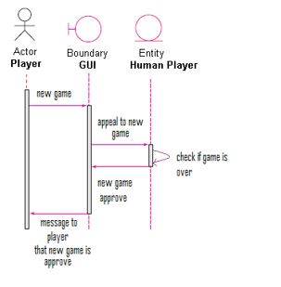
Continue…
Sequence Diagram

Slide 36
Continue…
Use case: Player chooses new game (anomaly 1)
Brief Description Player chooses new game.
Step-by-Step Description Player chooses to start a new game. Player will get a message that informs player that new game has begun.

Slide 37
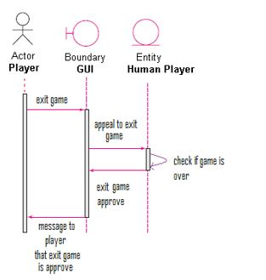
Continue…
Sequence Diagram

Slide 38
Continue…
Use case: Player chooses to exit game. (Anomaly 2)
Brief Description Player exits game.
Step-by-Step Description Player does not want to start a new game and exits game. Player will not start a new game and the game will close down.

